Slide 1

DATA HANDLING AND
VISUALIZATION
PROJECT

Slide 2

Power BI Project Presentation
Anand Stationery & Super Mart Sales Dashboard
Transforming retail data into actionable business intelligence for nationwide growth

Slide 3

Dataset Overview
Anand Stationery & Super Mart is a retail and wholesale distributor based in Dharampeth, Nagpur, supplying stationery, office furniture, and supplies to schools, coaching institutes, and resellers across India.
Coverage
Data Source
Key Fields
20+ states including Maharashtra, Tamil Nadu, Kerala, Gujarat, and Delhi
Monthly CSV exports from Tally ERP for accounting and logistics tracking
Order ID, Dates, Customer Name, Ship Mode, City, Category, Sales, Quantity, Discount, Profit

Slide 4

Project Scope & Strategic Goals
The objective was to build an interactive Power BI dashboard enabling data-driven decision-making for nationwide sales analysis and logistics optimisation.
1
State-wise and category-wise sales analysis
Understand regional performance and product category trends across markets
2
Identify profitable regions and opportunities
Locate high-value markets for targeted expansion and growth initiatives
3
Analyse transportation delays and efficiency
Optimise logistics and identify bottlenecks affecting delivery performance
4
Compare local versus interstate performance
Evaluate Nagpur local operations against pan-India sales strategy

Slide 5
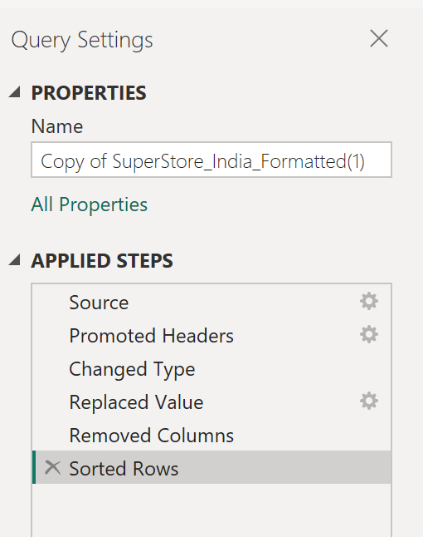
Data Preprocessing & Dashboard Architecture
Data Cleaning with Power Query
Removed null values and standardised data types
Filtered irrelevant or duplicate records
Created derived columns: Month, Year, Region
Validated consistency across all fields
Interactive Dashboard Components
Sales Trend Chart
Time-series line chart tracking monthly and yearly sales performance
Profit by Region
Bar chart comparing profitability across states and geographic zones
Category Distribution
Pie chart showing product category contribution to total sales
Geographic Map
Interactive map visual displaying sales distribution across India
Dynamic Slicers
Filters by state, product category, and ship mode for real-time exploration

Slide 6
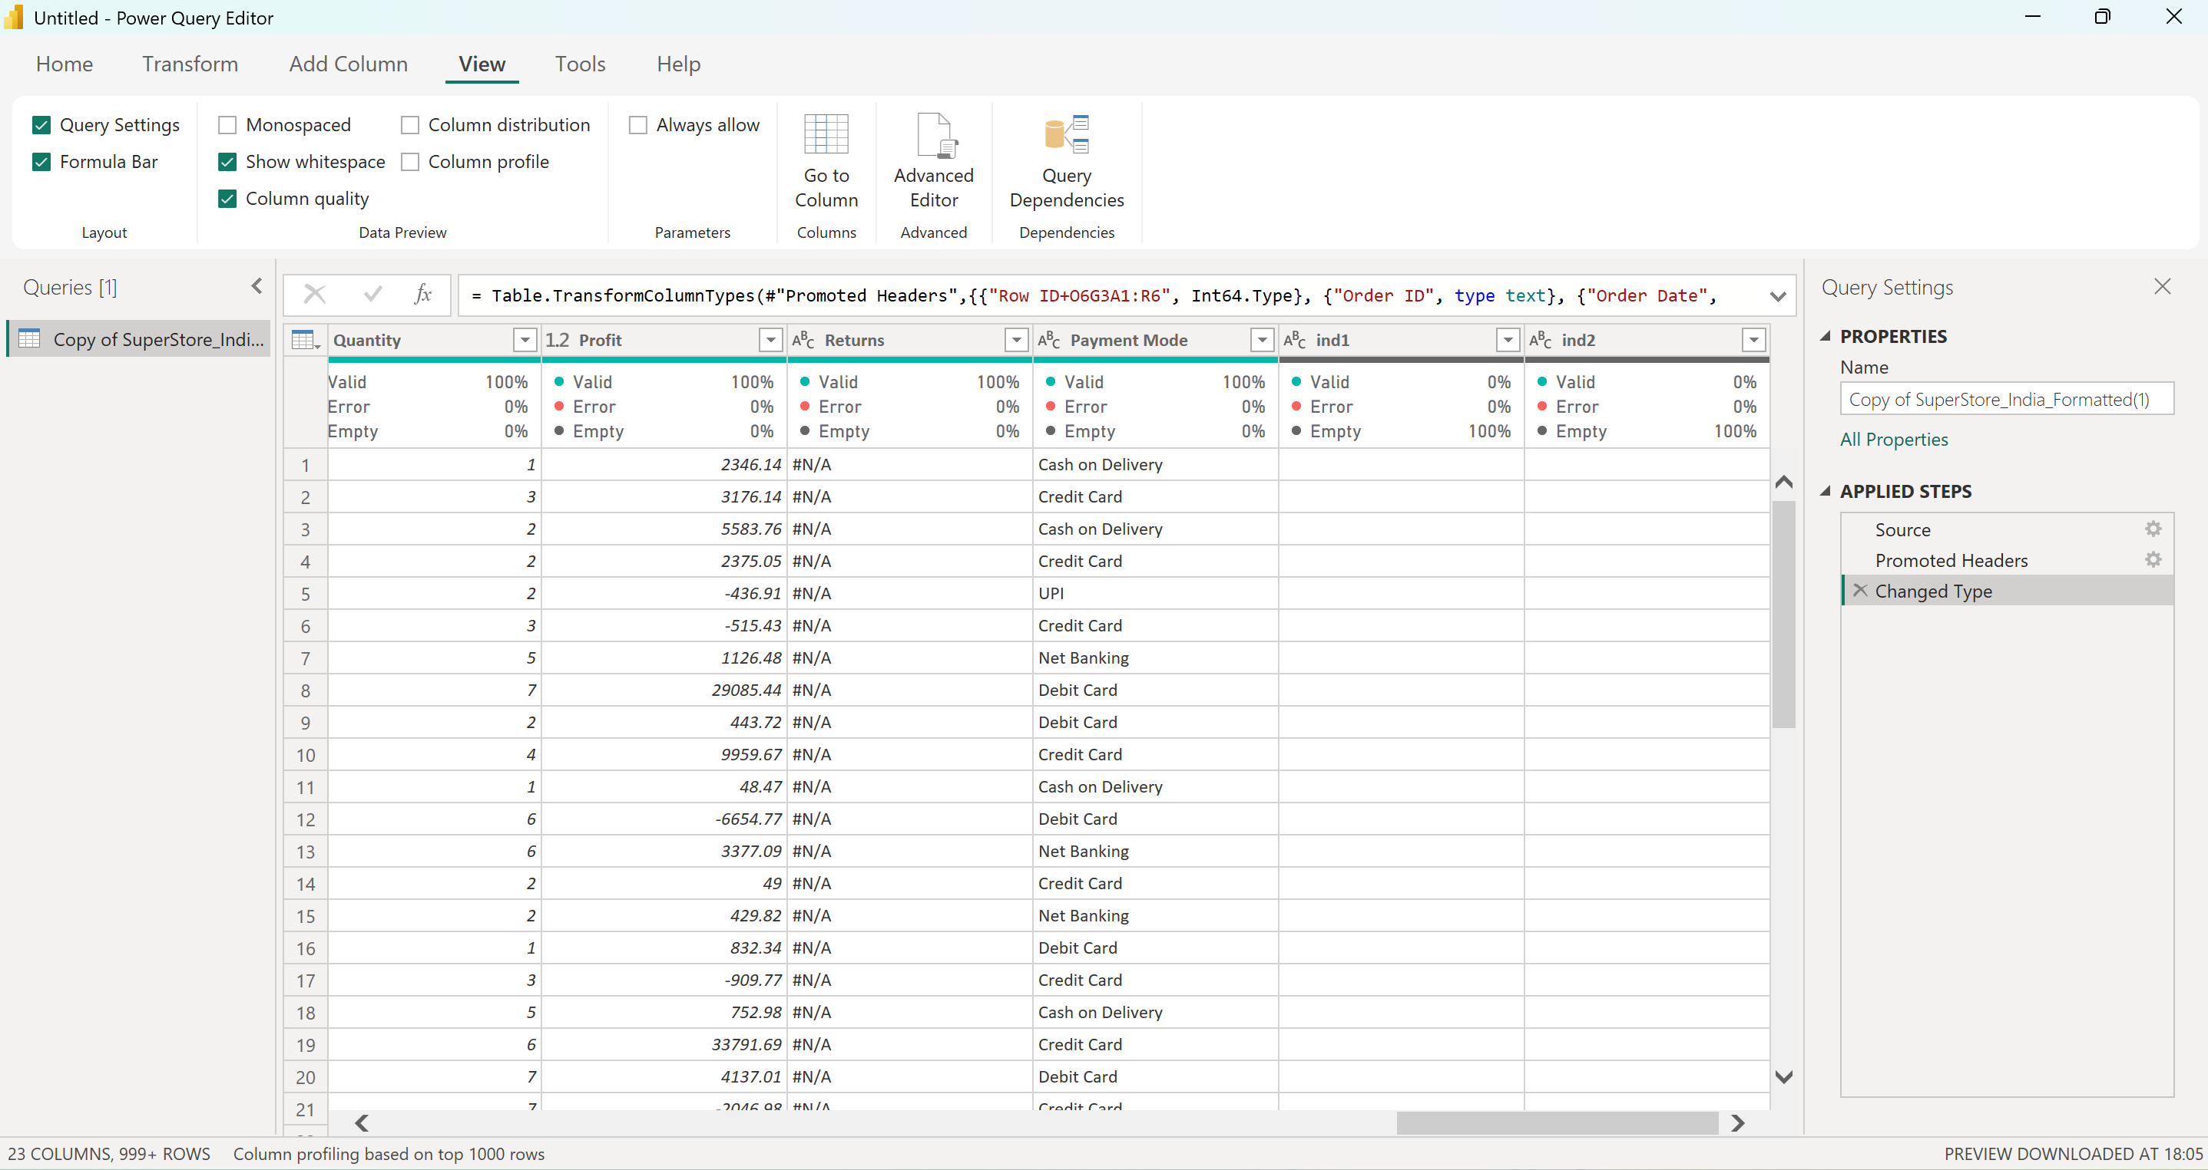

Slide 7
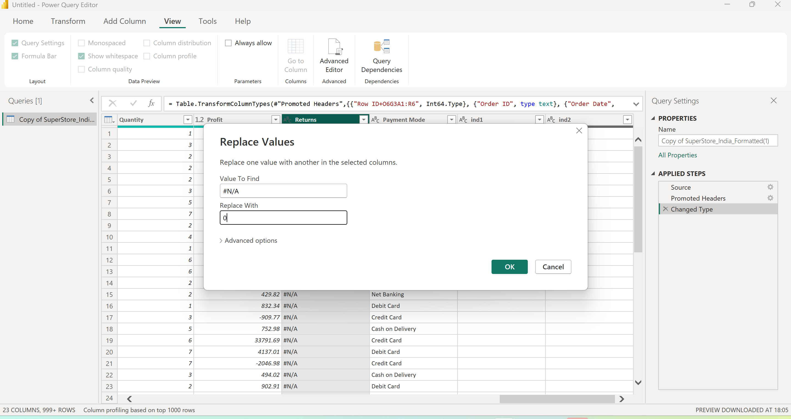

Slide 8
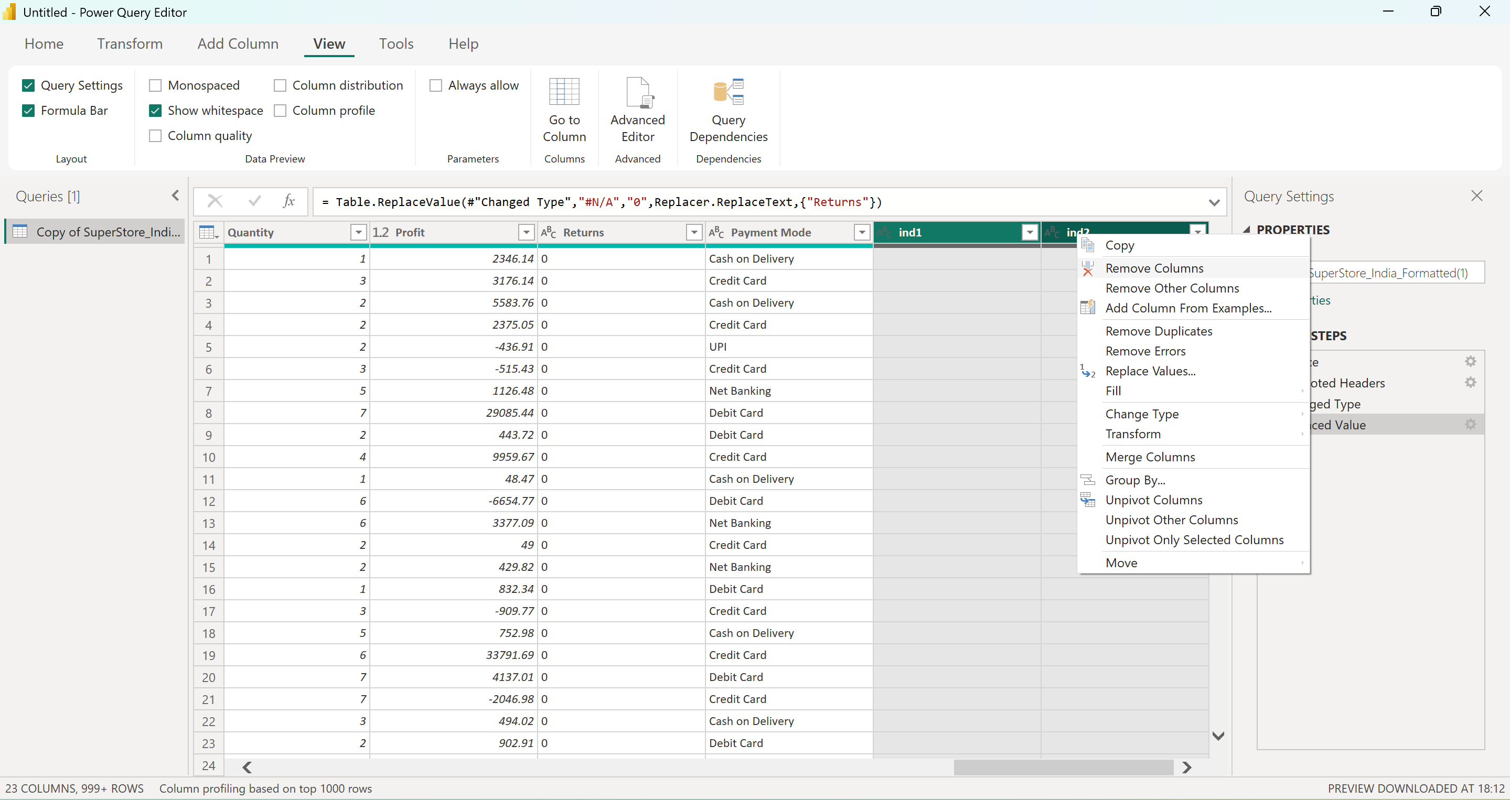

Slide 9
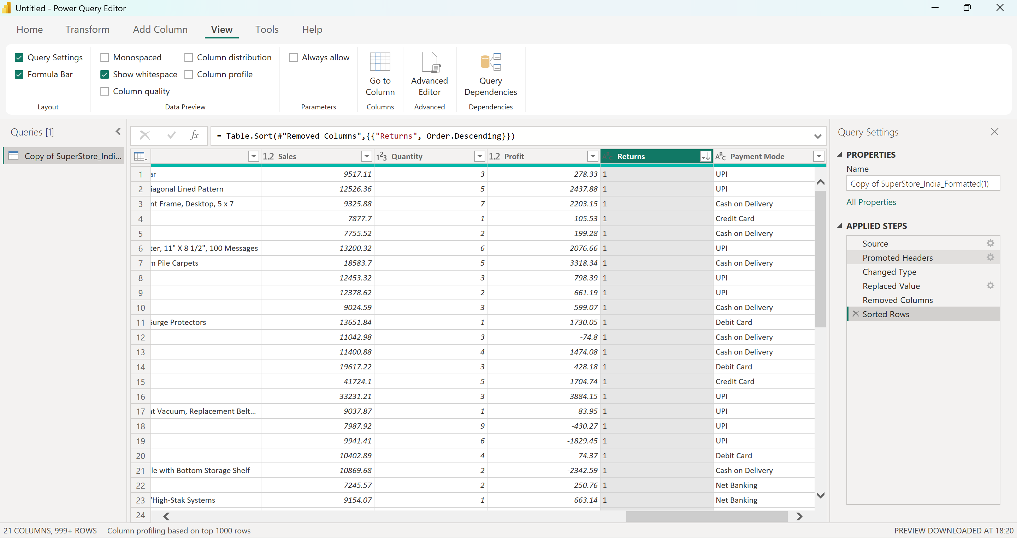

Slide 10
1) Total Sales = SUM('SuperStore_India'[Sales])
2) Profit Margin % =
DIVIDE(
SUM('SuperStore_India'[Profit]),
SUM('SuperStore_India'[Sales])
)
3) Yearly Growth % =
VAR CurrentYearSales = SUM('SuperStore_India'[Sales])
VAR LastYearSales =
CALCULATE(
SUM('SuperStore_India'[Sales]),
SAMEPERIODLASTYEAR('SuperStore_India'[Order Date])
)
RETURN
DIVIDE(CurrentYearSales - LastYearSales, LastYearSales)
4) Delayed Orders =
COUNTROWS(
FILTER(
'SuperStore_India',
'SuperStore_India'[Ship Days] > 3
)
)
Advanced Analytics with DAX & Forecasting
Leveraged DAX to create sophisticated calculated measures enabling deeper insights and predictive analysis.
1
Total Sales Measure
SUM(Sales) – aggregate revenue across all transactions and periods
2
Profit Margin Analysis
DIVIDE(SUM(Profit), SUM(Sales)) – measures profitability percentage by segment
3
Yearly Growth Rate
CALCULATE(SUM(Sales), SAMEPERIODLASTYEAR(Date)) – year-on-year performance tracking
4
Delayed Orders
COUNTROWS(FILTER(...)) – identifies courier delays exceeding 3-day thresholds
Predictive Forecasting
Power BI's analytics pane enables forecast lines on sales trends, predicting future performance with confidence intervals for strategic planning.

Slide 11
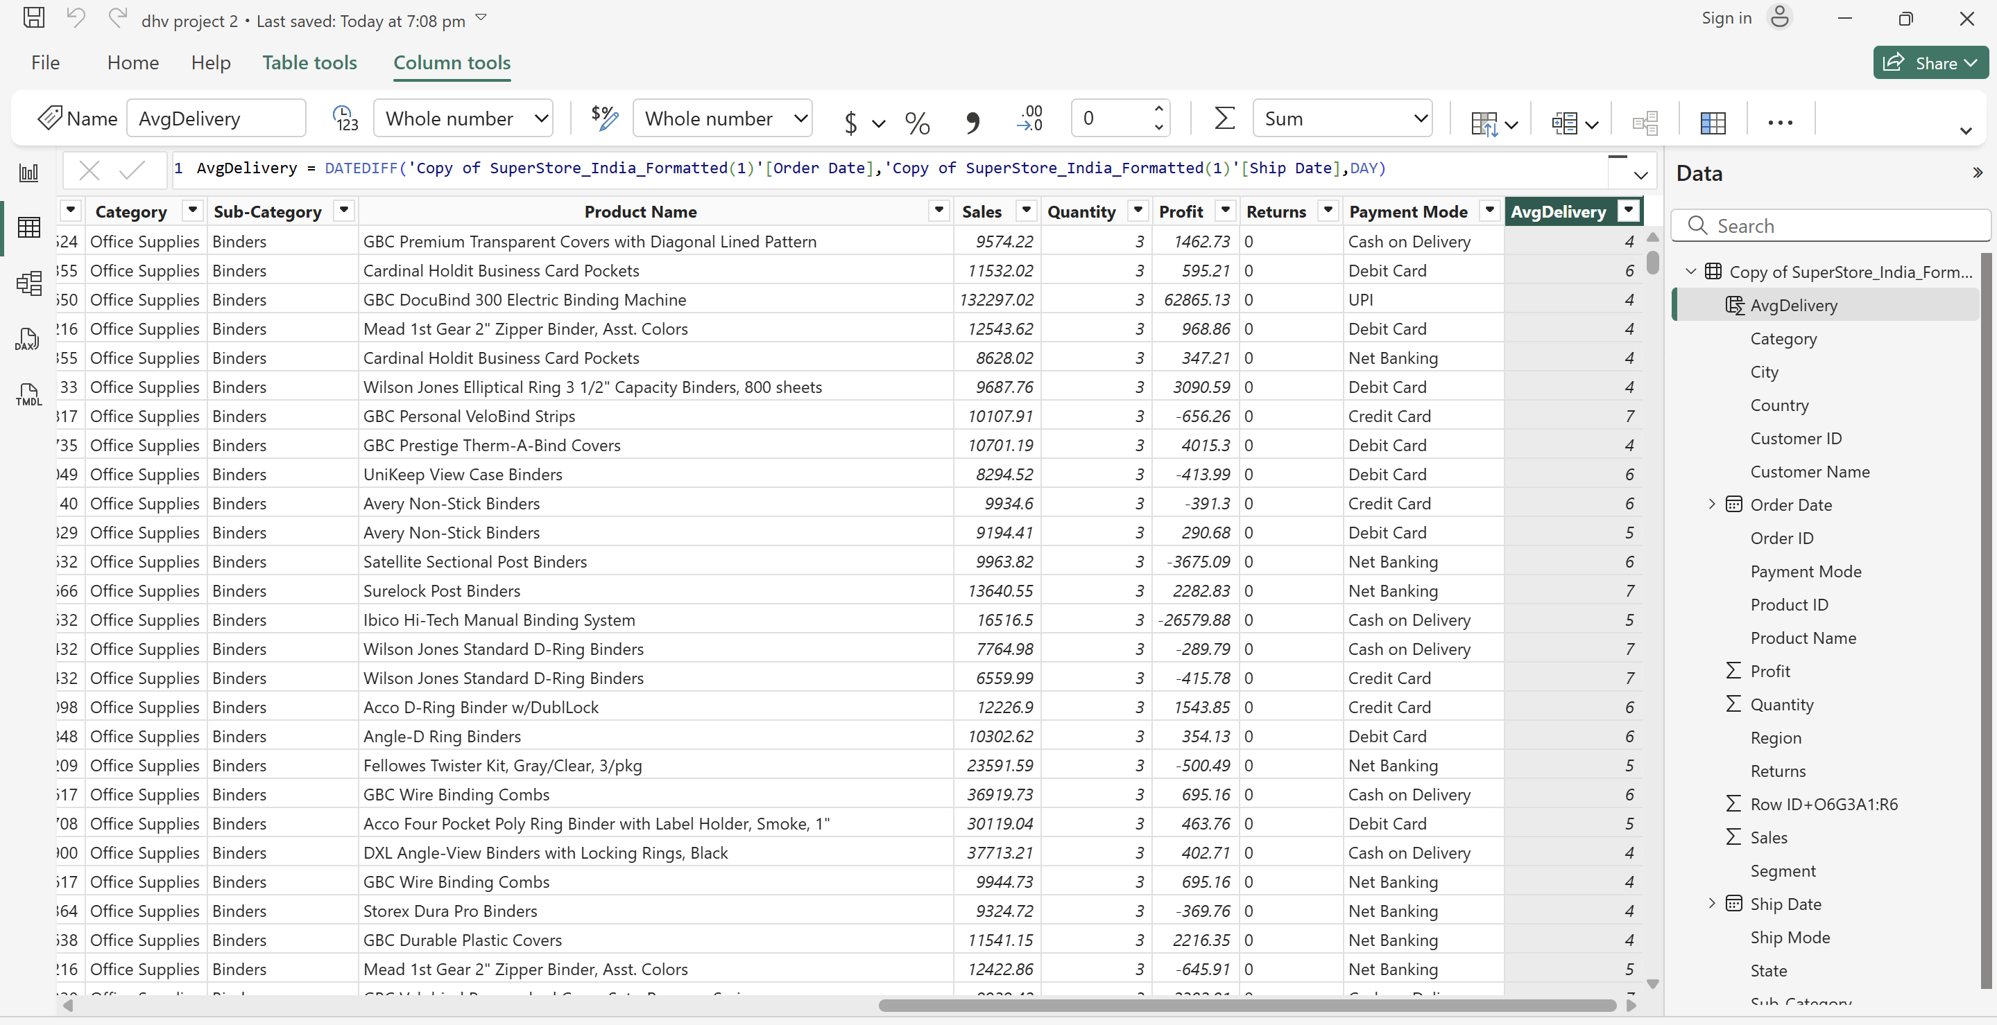

Slide 12
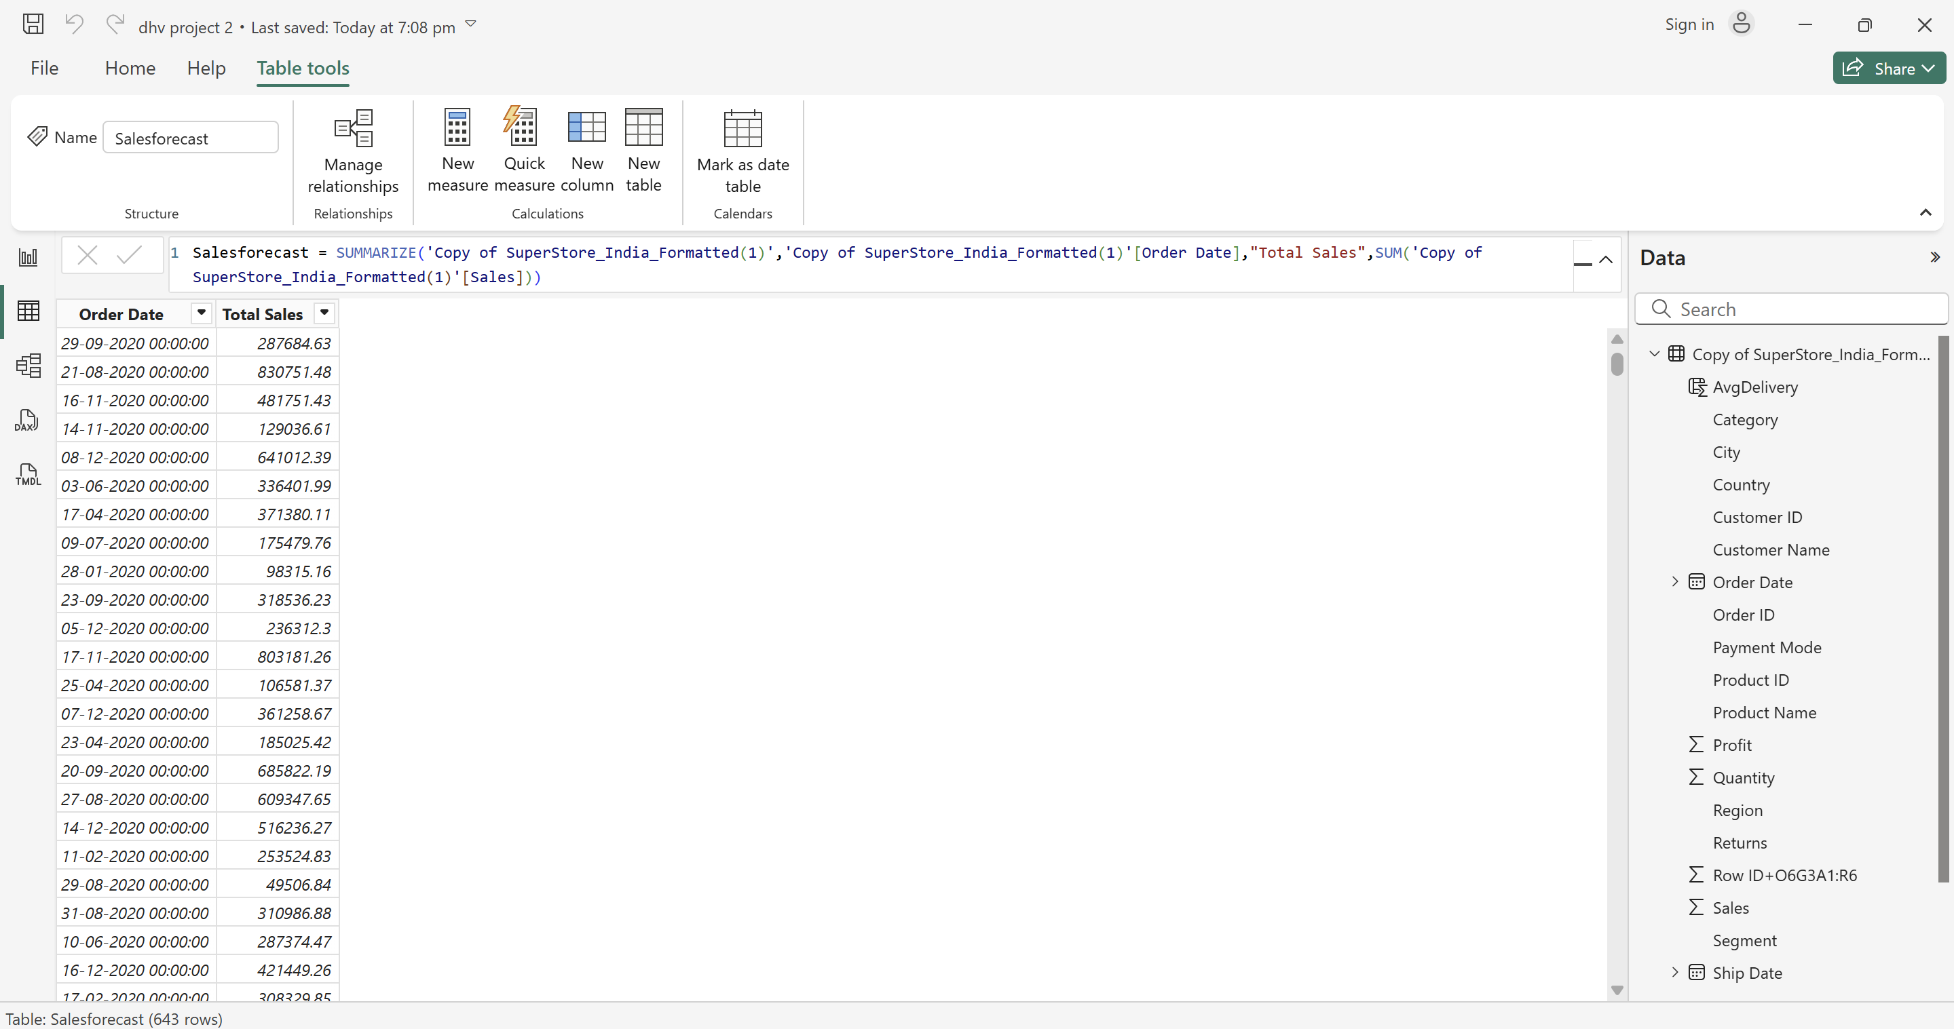

Slide 13
Identify which states have the highest number of repeat customers
1) Orders per Customer =
CALCULATE(
DISTINCTCOUNT('SuperStore_India'[Order ID]),
ALLEXCEPT('SuperStore_India', 'SuperStore_India'[Customer Name])
)
2) Customer Type =
IF([Orders per Customer] > 1, "Repeat Customer", "New Customer")
3) Repeat Customers per State =
CALCULATE(
DISTINCTCOUNT('SuperStore_India'[Customer Name]),
'SuperStore_India'[Customer Type] = "Repeat Customer"
)
4) Total Customers per State =
DISTINCTCOUNT('SuperStore_India'[Customer Name])
5) Repeat Customer % =
DIVIDE([Repeat Customers per State], [Total Customers per State])

Slide 14


Key Findings & Strategic Recommendations
Maharashtra & Madhya Pradesh Opportunity
Highest repeat customer base – implement loyalty programmes and personalised outreach to strengthen relationships
Southern Regional Potential
Tamil Nadu and Kerala show fewer but high-value bulk orders – launch targeted campaigns for large-scale clients
Courier Logistics Optimisation
Express and standard courier modes exceed 3-day delays – transition to faster logistics partners or in-house transport
Local Market Expansion
Nagpur local operations represent 15–20% of revenue – invest in local distribution and retail presence strengthening

Slide 15
Project Success
This Power BI dashboard successfully delivered comprehensive sales intelligence, enabling Anand Stationery & Super Mart to make informed, data-driven decisions across all operational dimensions.
State-wise & Category Analysis
Profitable Regions Identified
Logistics Insights
Clear growth opportunity mapping
Actionable transportation optimisation data
Complete regional performance visibility
Local vs Interstate Clarity
Forecasting Capability
Strategic performance benchmarking
Future-focused planning foundation
Outcome: Power BI transforms raw transactional data into strategic business intelligence, enabling sustainable growth and competitive advantage.

